Slide 1
Introduction to Network Analysis and Visualization
Kazutaka “Taka” Takahashi
kazutaka@uchicago.edu
Research Computing Center

Slide 2
Git depot for the files and today’s presentation:
https://github.com/rcc-uchicago/network_visualization
Very useful and comprehensive (analysis in particular) methods are available through our libraries:
The Structure and Dynamics of Networks
Author: Watts, Duncan J., Barabási, Albert-László, Newman, M. E. J.
http://web.b.ebscohost.com.proxy.uchicago.edu/ehost/ebookviewer/ebook?sid=2e6efeab-8174-4202-b8d5-b35c2fb0958f%40sessionmgr120&vid=0&format=EB
Networks: An Introduction
Author: Mark Newman
https://www-oxfordscholarship-com.proxy.uchicago.edu/view/10.1093/acprof:oso/9780199206650.001.0001/acprof-9780199206650

Slide 3
Programming packages:
We will focus on igraph (available for both Python and R):
For Python: https://igraph.org/python/
For R: https://igraph.org/r/
For Network visualization:
For Python: graphviz (for small network), NetworkX
For complehensive list:
https://github.com/briatte/awesome-network-analysis#python

Slide 4
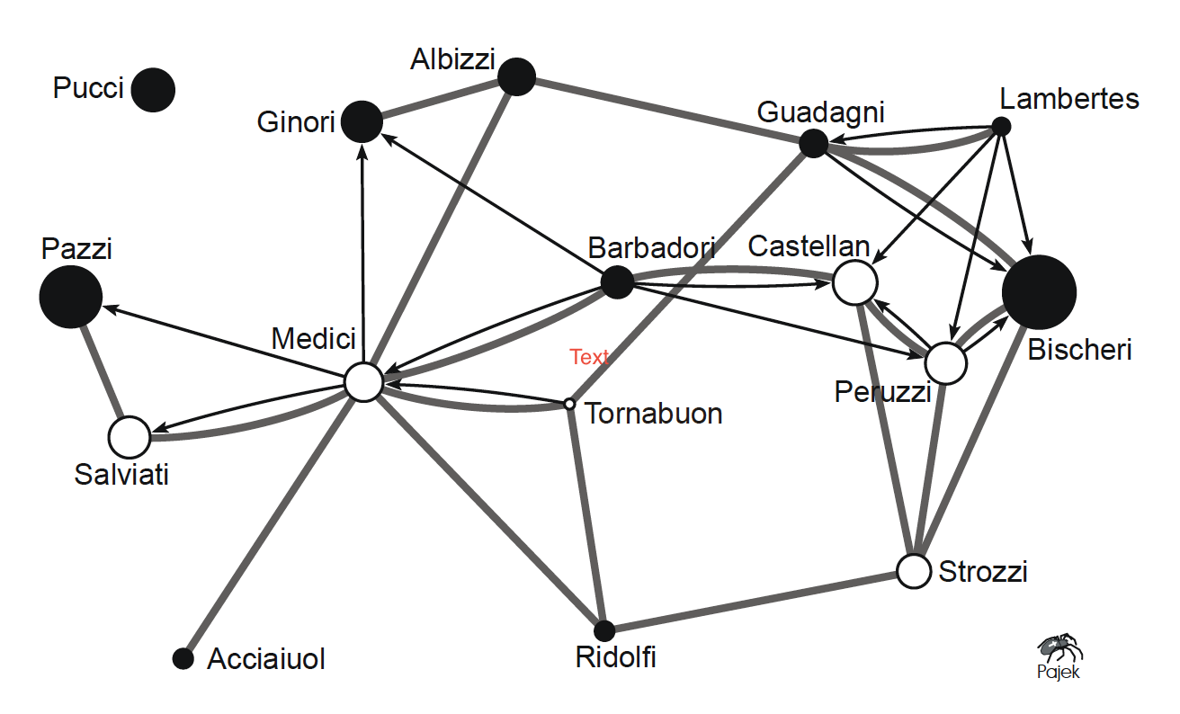
What is network?
Sociogram of marriage (grey edges) and business (black arcs) relations between 16 Florentine families (circa 1400 AD) (Prof. John Padgett, Political Science)
Notes:
Figure 1 illustrates the graph theoretical definition of a network. It shows a sociogram of marriage and business relations among 16 families in Florence (Italy) around 1400 AD. The data are part of a larger dataset collected and analyzed by John F. Padgett. In a sociogram, vertices are represented by circles, so each family is represented by a circle. Lines, connecting two circles in the sociogram, can be of two types: directed or undirected. Here, directed lines represent business relations among families. They are drawn as black arcs in Figure 1, pointing towards the more prosperous family. Marriage relations between families are undirected lines or edges in the network. They are represented by grey lines in the sociogram.

Slide 5
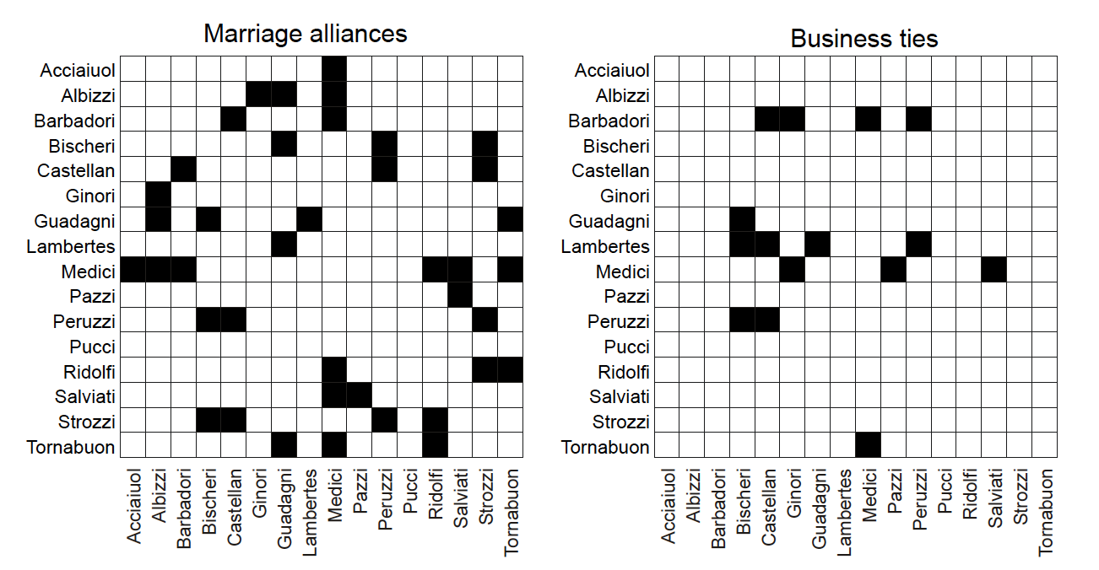
What is network?
Sociomatrices: marriage ties and business ties. (Prof. John Padgett, Political Science)
Notes:
The network of Florentine families contains two different relations. As a consequence, two families are sometimes connected by two lines: both a marriage edge and a business arc. Loops do not occur, although it is not impossible that members of the same family trade among themselves. In graph theory, a simple graph is a graph without multiple lines and, in the case of an undirected graph, without loops. A simple graph can easily be stored in a matrix, which is called an adjacency matrix or sociomatrix. So if we split the two relations in this network, we would obtain two simple graphs that can be represented by sociomatrices

Slide 6
What is network theory?
Or rather, what we want to cover today is an introduction of graph theory which deals with representations and analysis of networks

Slide 7
What is data visualization?
Creating appropriate and informative pictures of a dataset
Iterative exploration of data

Slide 8
What is Graph theory?
Graph theory is the study of graphs, which are mathematical
representation of a network used to model pairwise relations
between objects.
A graph consists of a set of "vertices" or "nodes", with certain
pairs of these nodes connected by "edges" (undirected) or
"arcs" (directed).
A graph may be undirected, meaning that there is no distinction
between the two vertices associated with each edge, or directed,
meaning that its arcs may be directed from one vertex to
another.

Slide 9
Visualization Definitions
Data Visualization
Broad term for visual representations of any data
Scientific Visualization (Contact me or Teodora at RCC for this type)
always about physical objects
using data with an inherent spatial component
E.g., wind tunnel vector data or three-dimensional (3D) medical images

Slide 10
A graph is represented by two sets
A vertex set V of the entities participating in the network. In the
rest of the slides typically, n will be the number of vertices
Also called node or actor set
.
An edge set E of the connections between vertices. In the rest
of the slides typically, m will be the number of edges
Also called link or tie set

Slide 11
Graph terminology
A graph whose vertices are connected by at most one link is called simple network or simple graph
When two nodes connect with more than one edge, we refer to all those edges collectively as multiedge. The corresponding graph is called multigraph
Depending on the type of connection a node might be connected to itself - Self-edges or self-loops

Slide 12
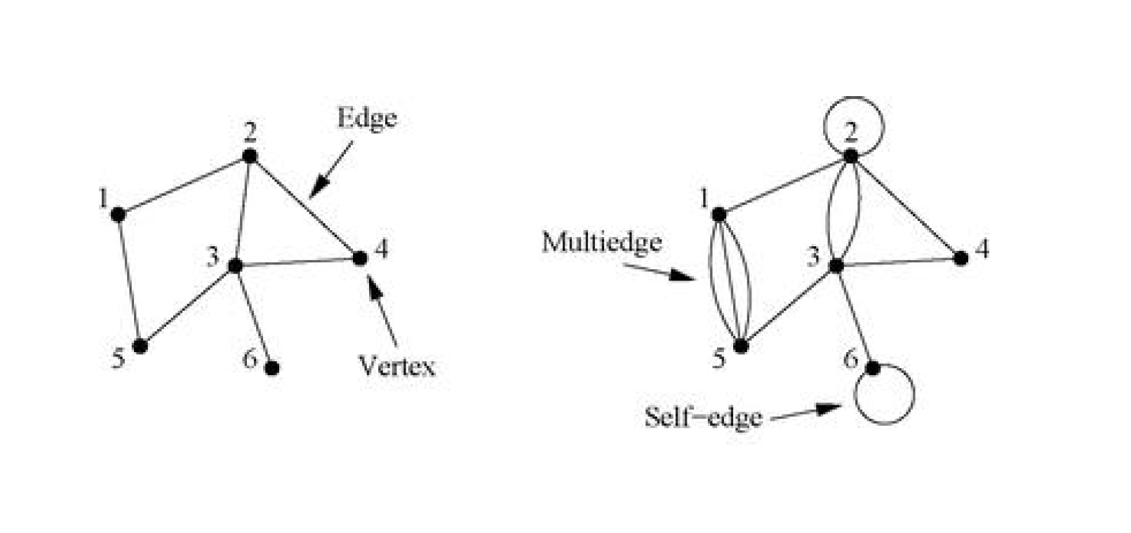
Example

Slide 13
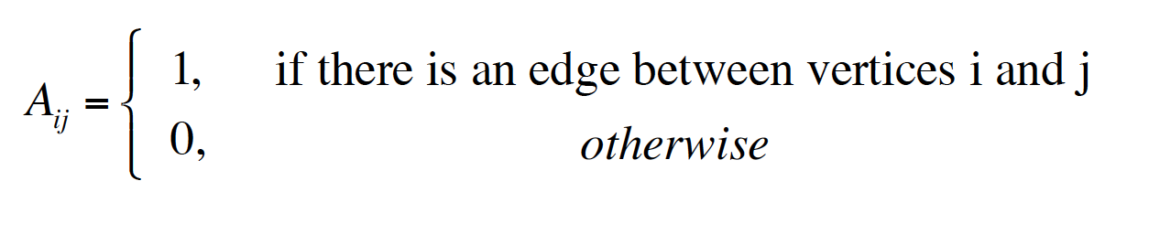
How can we characterizer network connections? - The adjacency matrix
If we label the nodes with IDs 1, 2, … n we can denote each
edge as a pair (i,j). This is an edge list specification. Good for storing and processing networks in computers, but not for
mathematical development (we will revisit this after the following)
The adjacency matrix A of a simple graph is a matrix with
elements Aij such that:

Slide 14
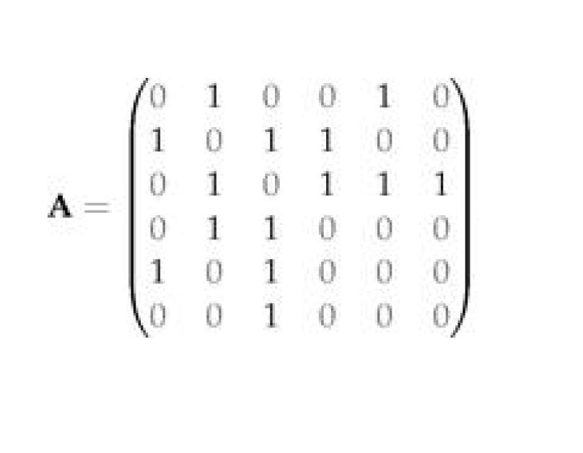
Example

Slide 15
Observations
For the (typical) case of no self-loops, the diagonal of the
matrix is all 0
For undirected networks, since the existence of edge (i,j)
assumes the existence of the edge (j,i), matrix A is symmetric
Multiedges are represented by setting the corresponding
entry equal to the number of distinct edges

Slide 16
For graph analysis and visualization: https://igraph.org/python/

Slide 17
R code based on package igraph: generate graph from adjacency matrix
library(igraph)
#Generate graph object from adjacency matrix
adjm_u<-matrix(
c(0, 1, 0, 0, 1, 0,
1, 0, 1, 0, 1, 0,
0, 1, 0, 1, 0, 0,
0, 0, 1, 0, 1, 1,
1, 1, 0, 1, 0, 0,
0, 0, 0, 1, 0, 0), # the data elements
nrow=6, # number of rows
ncol=6, # number of columns
byrow = TRUE) # fill matrix by rows
g_adj_u <- graph.adjacency(adjm_u, mode="undirected")
tkplot(g_adj_u)

Slide 18
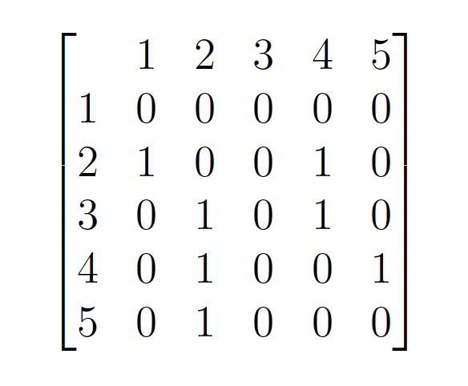
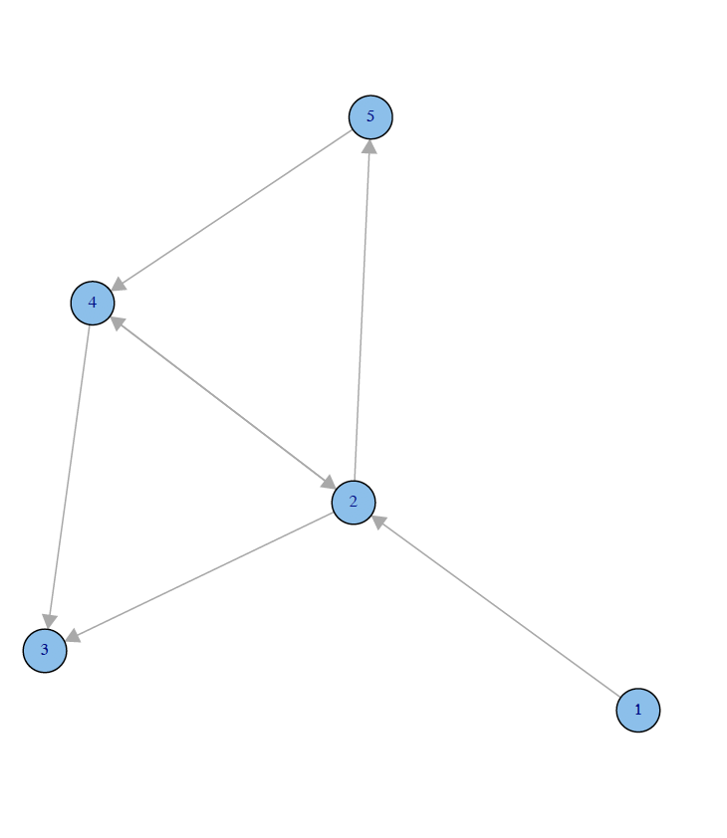
Example - Adjacency matrix: directed graph
A=
Note the direction of the edge runs from
the second index to the first: counter-intuitive,
butconvenient mathematically!

Slide 19
R code based on package igraph: generate graph from adjacency matrix
library(igraph)
#Generate graph object from adjacency matrix
adjm_d<-matrix(
c(0, 1, 0, 0, 0,
0, 0, 1, 1, 1,
0, 0, 0, 0, 0,
0, 1, 1, 0, 0,
0, 0, 0, 1, 0), # the data elements
nrow=5, # number of rows
ncol=5, # number of columns
byrow = TRUE) # fill matrix by rows
g_adj_d <- graph.adjacency(adjm_d, mode="directed")
tkplot(g_adj_d)

Slide 20
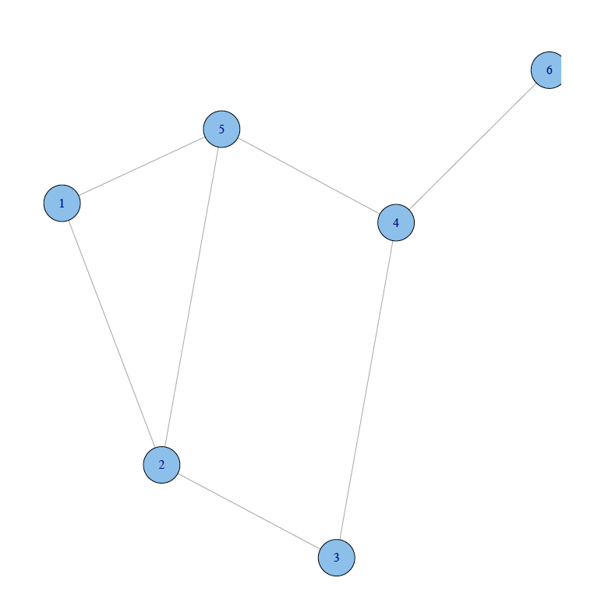
Another graph representation – Edge list Undirected graph
Edge List:
( 1,2 )
( 2,3 )
( 2,4 )
( 4,2 )
( 2,5 )
( 4,3 )
( 5,4 )

Slide 21
R code based on package igraph: generate undirected graph from edge list
library(igraph)
#Generate graph object from edge list
el_u <- matrix( c(1, 2, 1, 5, 2,3,2,5,3,4,4,5,4,6), nc=2, g_el_u <- graph.edgelist(el_u,directed=FALSE)
tkplot(g_el_u)

Slide 22
Edge list - Directed graph
Edge List:
(1,2)
(2,3)
(2,4)
(4,2)
(2,5)
(4,3)
(5,4)

Slide 23
R code based on package igraph: generate directed graph from edge list
library(igraph)
#Generate graph object from edge list
el_d <- matrix( c(1, 2, 2, 3, 2,4,4,2,2,5,4,3,5,4), nc=2, g_el_d <- graph.edgelist(el_d,directed=TRUE)
tkplot(g_el_d)

Slide 24
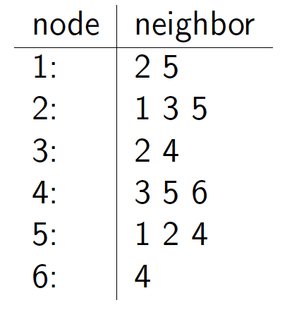
Another representation:Combining the two – Adjacency list: undirected graph
Adjacency list:
Notes:
Easier to work with if network is large and parse, and quick in retrieving all neighbors for a node

Slide 25
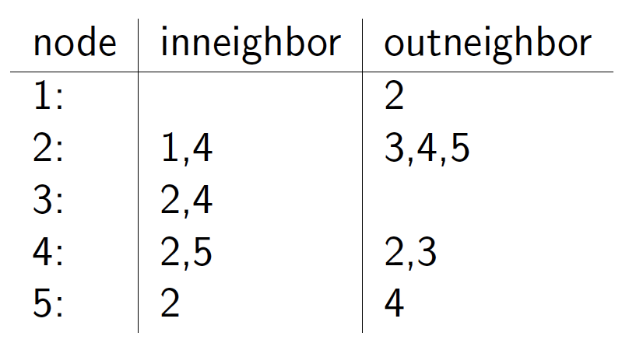
Adjacency list: Directed graph
Adjacency list:
Notes:
Directions matter -

Slide 26
Graph-theoretic basic concepts
Density
Degree, indegree and outdegree
Path and cycles
Distance, diameter
Components
Clustering coefficient
…

Slide 27
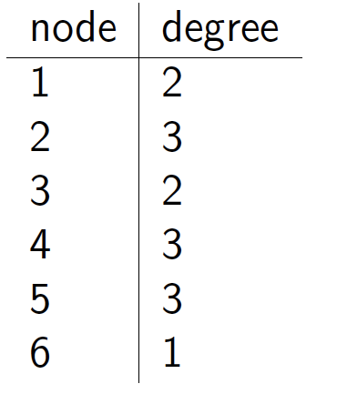
Degree for undirected graph
Degree of any node i: the number of
nodes adjacent to i. It can be
calculated from the three different
representations discussed earlier.
Notes:
Easier to work with if network is large and parse, and quick in retrieving all neighbors for a node

Slide 28
R code based on package igraph:degree
degree(g_adj_u)

Slide 29
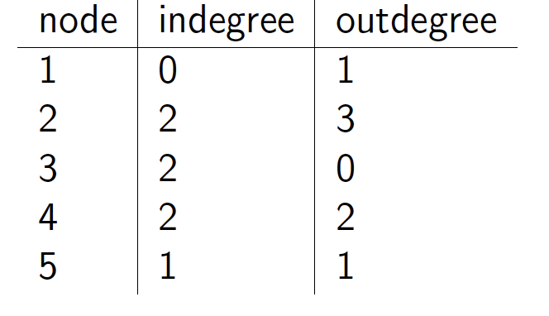
Degrees for directed graph
Since the connections are not symmetric,
We need to define in- and out-degrees
Indegree of any node i: the number of
nodes destined to i.
Outdegree of any node i: the number
of nodes originated at i.
Notes:
Directions matter -

Slide 30
R code based on package igraph:degree
degree(g_adj_d, mode="in")
degree(g_adj_d, mode="out")

Slide 31
Walk and Path
Walk: a walk is a sequence of nodes in
which each node is adjacent to the
next one:
A walk can intersect itself and pass
through the same link repeatedly.
Each time a link is crossed, it is
counted separately
One walk on the graph: 1; 2; 5; 1; 2; 3; 4.
In a directed network, the walk can
follow only the direction of an arrow.
A path is a walk without passing
through the same link more than once
(e.g. 1; 2; 5; 4; 3.).
Cycle: A path with the same start and
end node (e.g., 1; 2; 5)

Slide 32
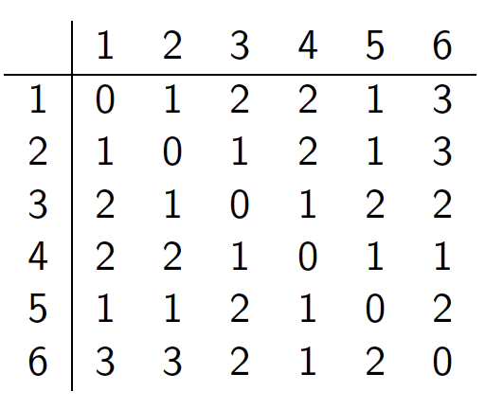
Distance
The distance D={dij} (shortest path, geodesic path) between two nodes i and j is the number of edges along the shortest path connecting them.
D=
Notes:
For directed graphs, the distance from one node A to another B is generally dierent from that from B to A.

Slide 33
R code based on package igraph:distance
shortest.paths(g_adj_u)

Slide 34
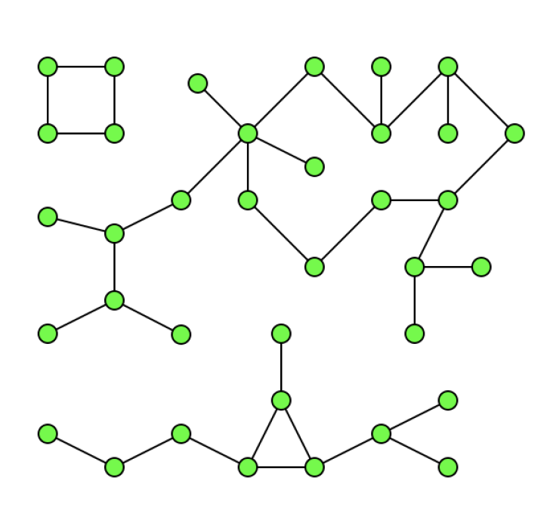
Connectivity and connected components for undirected graph
A graph is connected if there is a path between every pair of nodes.
A connected component is a subgraph in which any two nodes are connected to each other by paths, and which is connected to no additional nodes in the original graph.
Bridge: an edge whose deletion increases the number of connected components.
D=
Notes:
For directed graphs, the distance from one node A to another B is generally dierent from that from B to A.

Slide 35
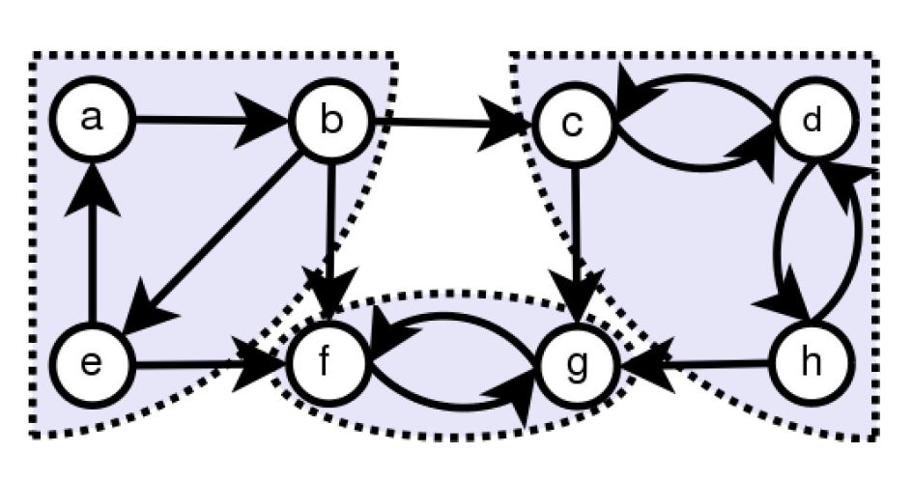
Connectivity and connected components for directed graph
A directed graph is strongly connected if there is a path from any node to each other node, and vice versa.
A directed graph is weakly connected if it is connected by ignoring the edge directions
A strongly connected component of a directed graph G is a subgraph that is strongly connected, and is maximal with this property: no additional edges or vertices from G can be included in the subgraph without breaking its property of being strongly directed.
D=
Notes:
A graph with three strongly connected components

Slide 36
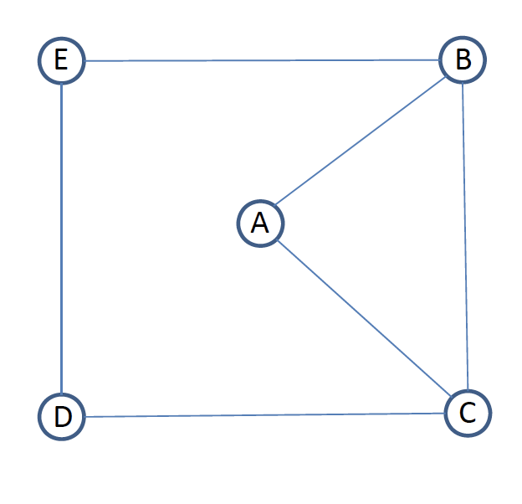
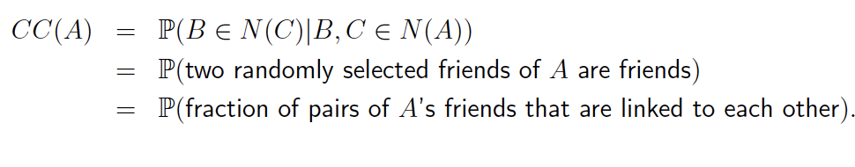
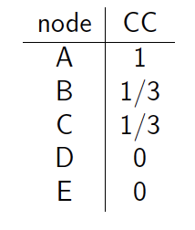
Clustering coecient
For any given node A and two randomly selected nodes B and C:
For the network
on the left:

Slide 37
R code based on package igraph: Clustering coecient
# First generate the graph from edge list
el_cc <- matrix( c("A", "B", "A","C", "B",
"C", "B","E","D","E","C","D"), nc=2, byrow=TRUE)
g_el_cc <- graph.edgelist(el_cc,directed=FALSE)
# Then calculate CC
transitivity(g_el_cc, type="localundirected")

Slide 38
What if there is more than on or off connection?
Notes:
Figure 1 illustrates the graph theoretical definition of a network. It shows a sociogram of marriage and business relations among 16 families in Florence (Italy) around 1400 AD. The data are part of a larger dataset collected and analyzed by John F. Padgett. In a sociogram, vertices are represented by circles, so each family is represented by a circle. Lines, connecting two circles in the sociogram, can be of two types: directed or undirected. Here, directed lines represent business relations among families. They are drawn as black arcs in Figure 1, pointing towards the more prosperous family. Marriage relations between families are undirected lines or edges in the network. They are represented by grey lines in the sociogram.

Slide 39
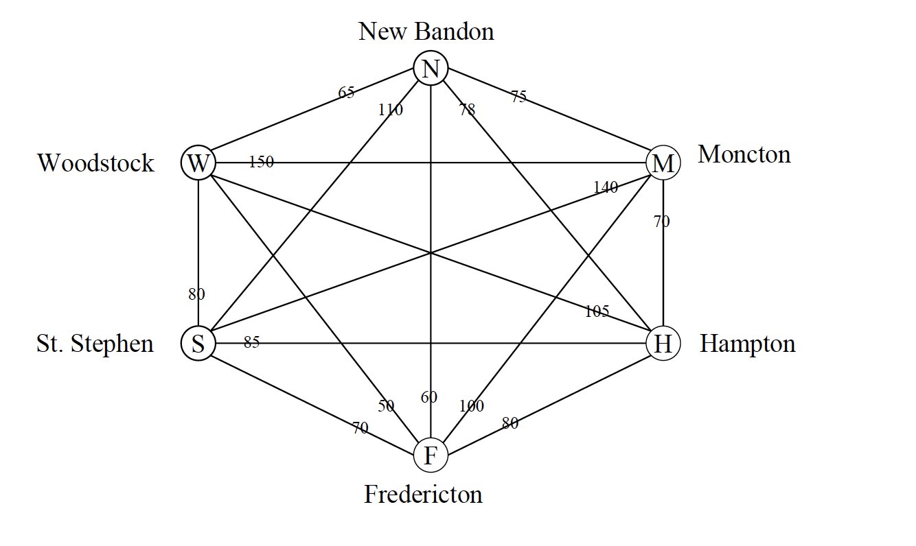
Weighted networks
Mobile phone calls, Collaboration network, and etc
Notes:
Figure 1 illustrates the graph theoretical definition of a network. It shows a sociogram of marriage and business relations among 16 families in Florence (Italy) around 1400 AD. The data are part of a larger dataset collected and analyzed by John F. Padgett. In a sociogram, vertices are represented by circles, so each family is represented by a circle. Lines, connecting two circles in the sociogram, can be of two types: directed or undirected. Here, directed lines represent business relations among families. They are drawn as black arcs in Figure 1, pointing towards the more prosperous family. Marriage relations between families are undirected lines or edges in the network. They are represented by grey lines in the sociogram.

Slide 40
Network visualization

Slide 41
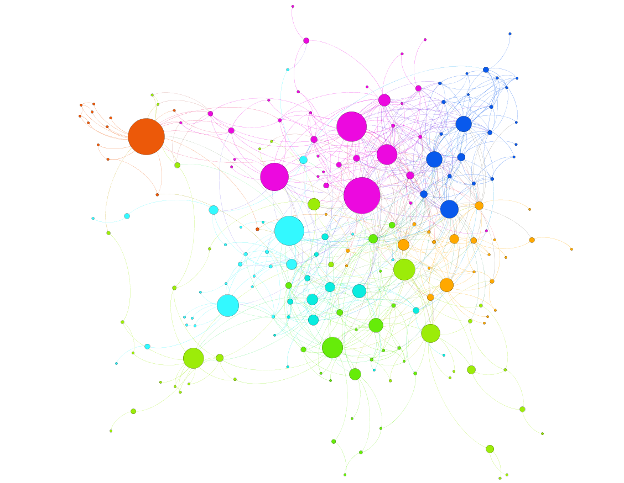
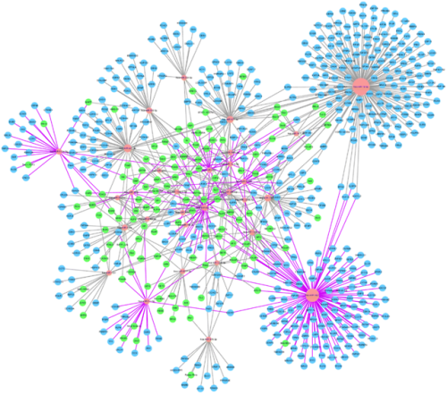
Many tools are available -
Cytoscape
Gephi
Facebook volunteer group network visualization in Gephi
By Nodus lab
MicroRNA expression profile of urinary exosomes in
Type IV lupus nephritis complicated by cellular crescent.
Li et al, J Biol Res (Thessalon). 2018 Dec; 25: 16.

Slide 42
Visualization Definitions
Information Visualization
Typically involve abstract, non-spatial data
Usually do not have inherent geometries by which to map information
E.g., financial data or document collection
Geographic Information Visualization (GIS)
Involve spatial data
Contain analysis of spatial data or tag location (and time) specific data

Slide 43

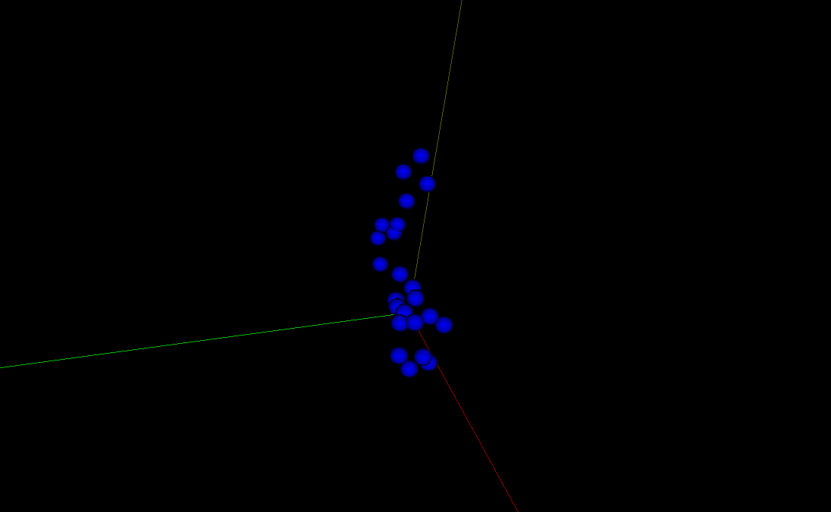
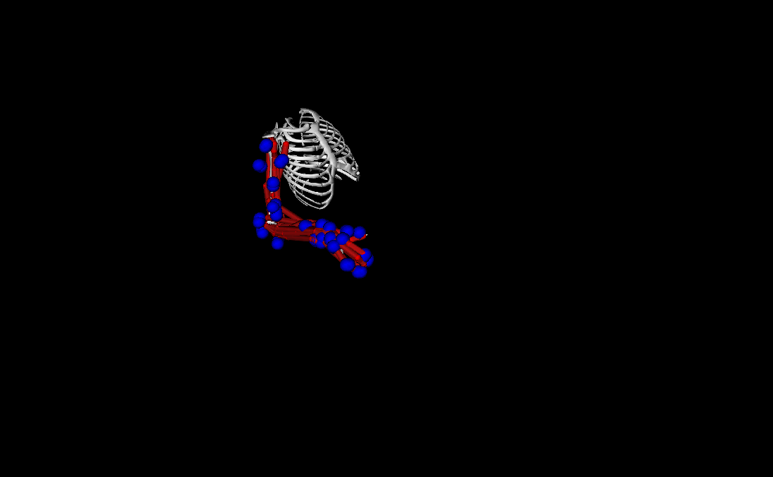
Scientific Visualization at RCC

Slide 44
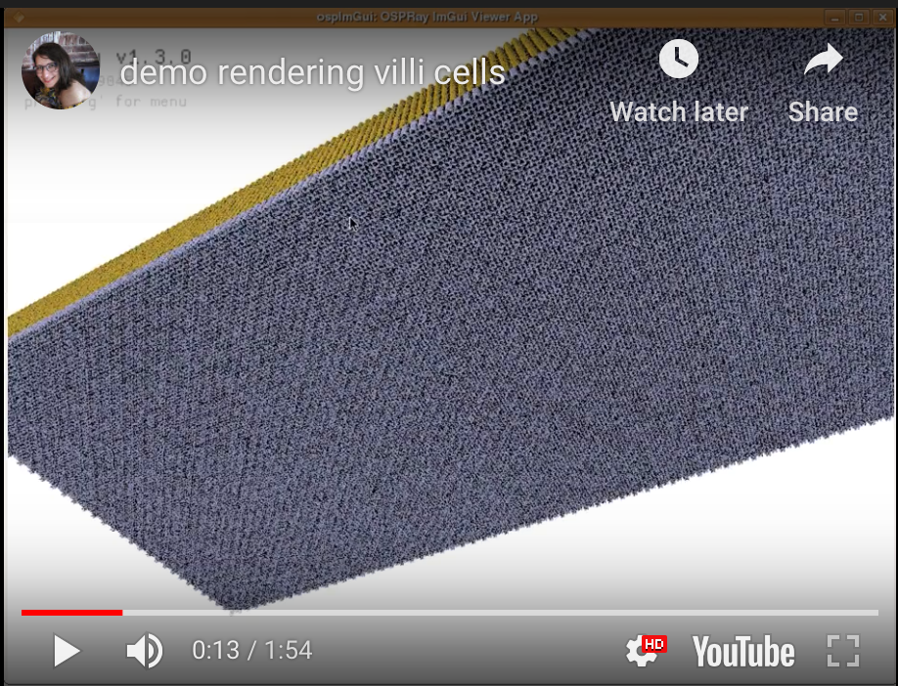
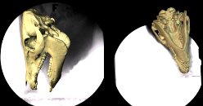
Scientific Visualization at RCC
https://youtu.be/Zgc6lKeLSsE
XROMM (various animal models available)
U Chicago by Taka and others from RCC with Prof. Ross from Department of Organismal Biology and Anatomy
VISUALIZING VILLI CELLS INSIDE HUMAN INTESTINE U Chicago by Dora from RCC with Department of Surgery,

Slide 45
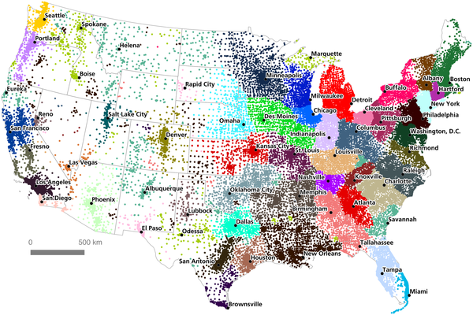

GIS - An Economic Geography of the United States: From Commutes to Megaregions
Dash Nelson G, Rae A (2016) An Economic Geography of the United States: From Commutes to Megaregions. PLOS ONE 11(11): e0166083. https://doi.org/10.1371/journal.pone.0166083
https://journals.plos.org/plosone/article?id=10.1371/journal.pone.0166083

Slide 46
Information Data Visualization - Why is this important?

Slide 47
“I keep saying that the sexy job in the next 10 years will be statisticians”
Hal Varian, Chief Economist Google
Statisticians will never have a sexy job. Data-powered storytellers will.

Slide 48
Visualization -> “Sanity” Check Statistics -> Quantify the “hunch”
Visualization != Sexy Pictures
Visualization -> Story telling (with your message)

Slide 49

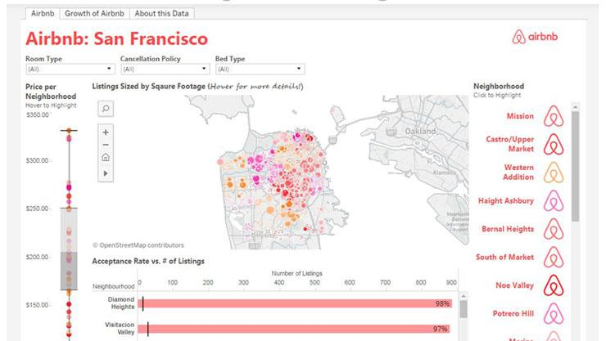
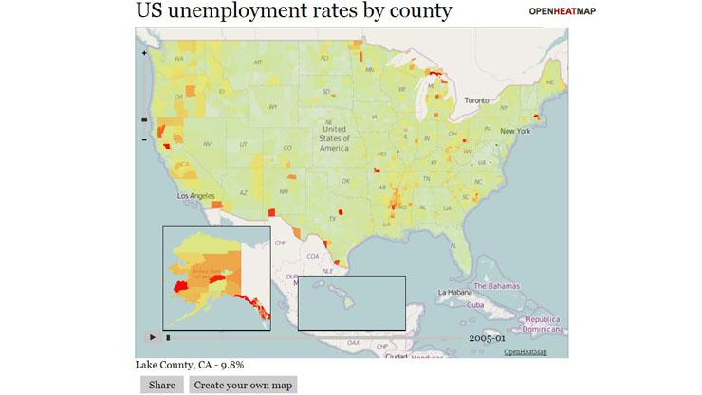
Visualization tools are everywhere
And most of them are for free!
https://www.pcmag.com/article/347315/10-free-data-visualization-tools

Slide 50
For Non-Developers/Coders: A few examples of free tools not requiring any coding:
Datawrapper is an online tool for making interactive charts.
Tableau Public is perhaps the most popular visualization tool which supports a wide variety of charts, graphs, maps and other graphics.
Raw defines itself as ‘the missing link between spreadsheets and vector graphics.
Timeline JS helps you create beautiful timelines without writing any code.

Slide 51
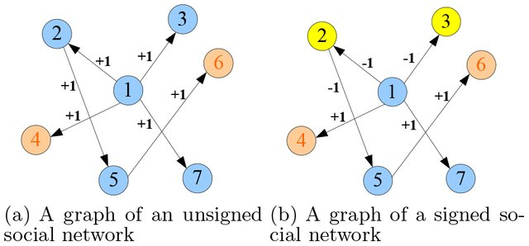
Or social network visualization

Slide 52
Examples

Slide 53
Join the RCC's image analysis and visualization Slack team
Notes:
An image is not just an arbitrary function, these images are actually projections of 3D scenes, of 3D points

Slide 54
rcc-visualization.slack.com/signup

